Slide 1

Chapter Three - Implementing Classes
Big Java by Cay Horstmann
Copyright © 2009 by John Wiley & Sons. All rights reserved.

Slide 2
Chapter Goals
To become familiar with the process of implementing classes
To be able to implement simple methods
To understand the purpose and use of constructors
To understand how to access instance variables and local variables
To be able to write javadoc comments
Big Java by Cay Horstmann
Copyright © 2009 by John Wiley & Sons. All rights reserved.

Slide 3
Instance Variables
Instance variables store the data of an object
Instance of a class: an object of the class
The class declaration specifies the instance variables:
  public class Counter
  {
  private int value;
  …
  }
Big Java by Cay Horstmann
Copyright © 2009 by John Wiley & Sons. All rights reserved.

Slide 4
Instance Variables
An instance variable declaration consists of the following parts:
  access specifier (private)
  type of variable (such as int)
  name of variable (such as value)
Each object of a class has its own set of instance variables
You should declare all instance variables as private
Big Java by Cay Horstmann
Copyright © 2009 by John Wiley & Sons. All rights reserved.

Slide 5
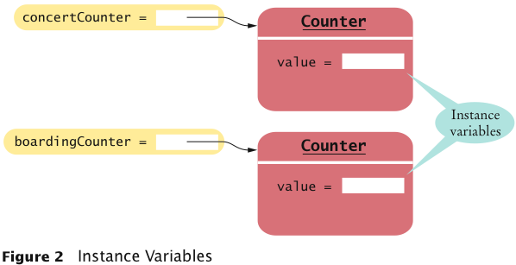
Instance Variables
Big Java by Cay Horstmann
Copyright © 2009 by John Wiley & Sons. All rights reserved.

Slide 6
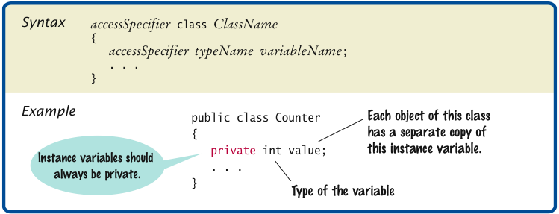
Syntax 3.1 Instance Variable Declaration
Big Java by Cay Horstmann
Copyright © 2009 by John Wiley & Sons. All rights reserved.

Slide 7
Accessing Instance Variables
The count method advances the counter value by 1:
  public void count()
  {
  value = value + 1;
  }
The getValue method returns the current value:
  public int getValue()
  {
  return value;
  }
Private instance variables can only be accessed by methods of the same class
Big Java by Cay Horstmann
Copyright © 2009 by John Wiley & Sons. All rights reserved.

Slide 8
Self Check 3.1
Supply the body of a method public void reset() that resets the counter back to zero.
Answer:
  public void reset()
  {
  value = 0;
  }
Big Java by Cay Horstmann
Copyright © 2009 by John Wiley & Sons. All rights reserved.

Slide 9
Instance Variables
Encapsulation is the process of hiding object data and providing methods for data access
To encapsulate data, declare instance variables as private and declare public methods that access the variables
Encapsulation allows a programmer to use a class without having to know its implementation
Information hiding makes it simpler for the implementor of a class to locate errors and change implementations
Big Java by Cay Horstmann
Copyright © 2009 by John Wiley & Sons. All rights reserved.

Slide 10
Self Check 3.5
Suppose you are working in a company that produces personal finance software. You are asked to design and implement a class for representing bank accounts. Who will be the users of your class?
Answer: Other programmers who work on the personal finance application.
Big Java by Cay Horstmann
Copyright © 2009 by John Wiley & Sons. All rights reserved.

Slide 11
Specifying the Public Interface of a Class
Behavior of bank account (abstraction):
  deposit money
  withdraw money
  get balance
Big Java by Cay Horstmann
Copyright © 2009 by John Wiley & Sons. All rights reserved.

Slide 12
Specifying the Public Interface of a Class: Methods
Methods of BankAccount class:
  deposit
  withdraw
  getBalance
We want to support method calls such as the following:
  harrysChecking.deposit(2000);
  harrysChecking.withdraw(500); System.out.println(harrysChecking.getBalance());
Big Java by Cay Horstmann
Copyright © 2009 by John Wiley & Sons. All rights reserved.

Slide 13
Specifying the Public Interface of a Class: Method Declaration
access specifier (such as public)
  return type (such as String or void)
  method name (such as deposit)
  list of parameters (double amount for deposit)
  method body in { }
Examples:
  public void deposit(double amount) { . . . }
  public void withdraw(double amount) { . . . }
  public double getBalance() { . . . }
Big Java by Cay Horstmann
Copyright © 2009 by John Wiley & Sons. All rights reserved.

Slide 14
Specifying the Public Interface of a Class: Method Header
access specifier (such as public)
return type (such as void or double)
method name (such as deposit)
list of parameter variables (such as double amount)
Examples:
  public void deposit(double amount)
  public void withdraw(double amount)
  public double getBalance()
Big Java by Cay Horstmann
Copyright © 2009 by John Wiley & Sons. All rights reserved.

Slide 15
Specifying the Public Interface of a Class: Constructor Declaration
A constructor initializes the instance variables
Constructor name = class name
  public BankAccount()
  {
  // body--filled in later
  }
Constructor body is executed when new object is created
Statements in constructor body will set the internal data of the object that is being constructed
All constructors of a class have the same name
Compiler can tell constructors apart because they take different parameters
Big Java by Cay Horstmann
Copyright © 2009 by John Wiley & Sons. All rights reserved.

Slide 16
BankAccount Public Interface
The public constructors and methods of a class form the public interface of the class:
  public class BankAccount
  {
  // private variables--filled in later
  // Constructors public BankAccount()
  {
  // body--filled in later
  }
  public BankAccount(double initialBalance)
  {
  // body--filled in later
  }
Continued
Big Java by Cay Horstmann
Copyright © 2009 by John Wiley & Sons. All rights reserved.

Slide 17
BankAccount Public Interface (cont.)
  // Methods
  public void deposit(double amount)
  {
  // body--filled in later
  }
  public void withdraw(double amount)
  {
  // body--filled in later
  }
  public double getBalance()
  {
  // body--filled in later
  }
  }
Big Java by Cay Horstmann
Copyright © 2009 by John Wiley & Sons. All rights reserved.

Slide 18
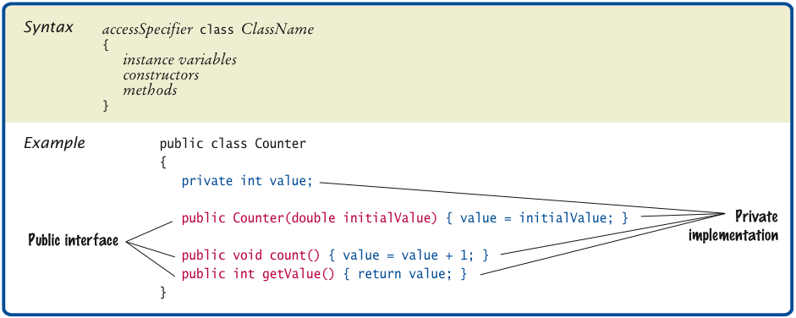
Syntax 3.2 Class Declaration
Big Java by Cay Horstmann
Copyright © 2009 by John Wiley & Sons. All rights reserved.

Slide 19
Self Check 3.7
What is wrong with this sequence of statements?
  BankAccount harrysChecking = new BankAccount(10000);
  System.out.println(harrysChecking.withdraw(500));
Answer: The withdraw method has return type void. It doesn’t return a value. Use the getBalance method to obtain the balance after the withdrawal.
Big Java by Cay Horstmann
Copyright © 2009 by John Wiley & Sons. All rights reserved.

Slide 20
Commenting the Public Interface
  /**
  Withdraws money from the bank account.
  @param amount the amount to withdraw
  */
  public void withdraw(double amount)
  {
  //implementation filled in later
  }
  /**
  Gets the current balance of the bank account.
  @return the current balance
  */
  public double getBalance()
  {
  //implementation filled in later
  }
Big Java by Cay Horstmann
Copyright © 2009 by John Wiley & Sons. All rights reserved.

Slide 21
Class Comment
  /**
  A bank account has a balance that can be changed by
  deposits and withdrawals.
  */
  public class BankAccount
  {
  . . .
  }
Provide documentation comments for
  every class
  every method
  every parameter
  every return value
javadoc -d docs *.java
Big Java by Cay Horstmann
Copyright © 2009 by John Wiley & Sons. All rights reserved.

Slide 22
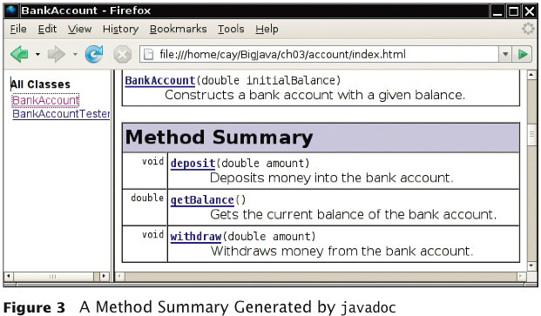
Javadoc Method Summary
Big Java by Cay Horstmann
Copyright © 2009 by John Wiley & Sons. All rights reserved.

Slide 23
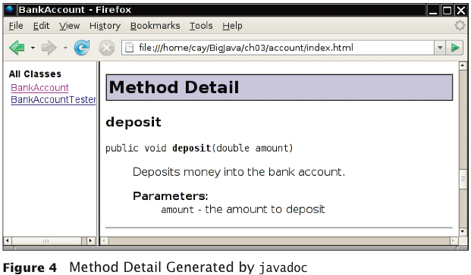
Javadoc Method Detail
Big Java by Cay Horstmann
Copyright © 2009 by John Wiley & Sons. All rights reserved.

Slide 24
Self Check 3.10
Suppose we enhance the BankAccount class so that each account has an account number. Supply a documentation comment for the constructor
public BankAccount(int accountNumber, double initialBalance)
Answer:
  /**
  Constructs a new bank account with a given initial balance.
  @param accountNumber the account number for this account
  @param initialBalance the initial balance for this account
  */
Big Java by Cay Horstmann
Copyright © 2009 by John Wiley & Sons. All rights reserved.

Slide 25
Implementing Constructors
Constructors contain instructions to initialize the instance variables of an object:
  public BankAccount()
  {
  balance = 0;
  }
  public BankAccount(double initialBalance)
  {
  balance = initialBalance;
  }
Big Java by Cay Horstmann
Copyright © 2009 by John Wiley & Sons. All rights reserved.

Slide 26
Constructor Call Example
Statement:
  BankAccount harrysChecking = new BankAccount(1000);
    Create a new object of type BankAccount
    Call the second constructor (because a construction parameter is supplied in the constructor call)
    Set the parameter variable initialBalance to 1000
    Set the balance instance variable of the newly created object to initialBalance
    Return an object reference, that is, the memory location of the object, as the value of the new expression
    Store that object reference in the harrysChecking variable
Big Java by Cay Horstmann
Copyright © 2009 by John Wiley & Sons. All rights reserved.

Slide 27
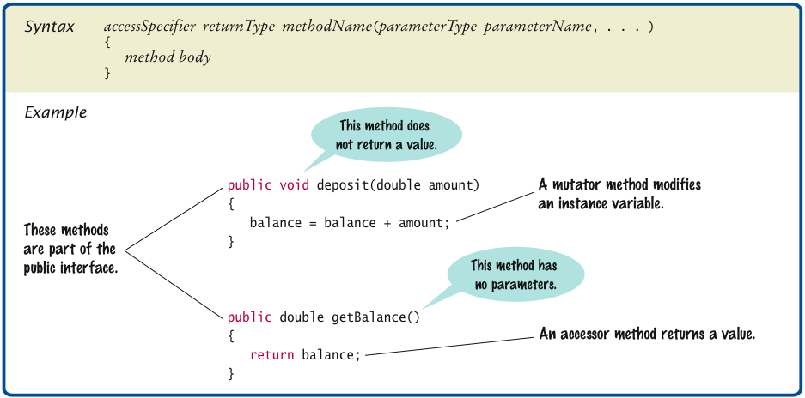
Syntax 3.3 Method Declaration
Big Java by Cay Horstmann
Copyright © 2009 by John Wiley & Sons. All rights reserved.

Slide 28
Implementing Methods
deposit method:
  public void deposit(double amount)
  {
  balance = balance + amount;
  }
Big Java by Cay Horstmann
Copyright © 2009 by John Wiley & Sons. All rights reserved.

Slide 29
Method Call Example
Statement:
  harrysChecking.deposit(500);
  Set the parameter variable amount to 500
  Fetch the balance variable of the object whose location is stored in harrysChecking
  Add the value of amount to balance
  Store the sum in the balance instance variable, overwriting the old value
Big Java by Cay Horstmann
Copyright © 2009 by John Wiley & Sons. All rights reserved.

Slide 30
Implementing Methods
public void withdraw(double amount)
{
balance = balance - amount;
}
public double getBalance()
{
return balance;
}
Big Java by Cay Horstmann
Copyright © 2009 by John Wiley & Sons. All rights reserved.

Slide 31
ch03/account/BankAccount.java
1 /**
2 A bank account has a balance that can be changed by
3 deposits and withdrawals.
4 */
5 public class BankAccount
6 {
7 private double balance;
8
9 /**
10 Constructs a bank account with a zero balance.
11 */
12 public BankAccount()
13 {
14 balance = 0;
15 }
16
17 /**
18 Constructs a bank account with a given balance.
19 @param initialBalance the initial balance
20 */
21 public BankAccount(double initialBalance)
22 {
23 balance = initialBalance;
24 }
Continued
Big Java by Cay Horstmann
Copyright © 2009 by John Wiley & Sons. All rights reserved.

Slide 32
ch03/account/BankAccount.java (cont.)
25
26 /**
27 Deposits money into the bank account.
28 @param amount the amount to deposit
29 */
30 public void deposit(double amount)
31 {
32 balance = balance + amount;
33 }
34
35 /**
36 Withdraws money from the bank account.
37 @param amount the amount to withdraw
38 */
39 public void withdraw(double amount)
40 {
41 balance = balance - amount;
42 }
43
Continued
Big Java by Cay Horstmann
Copyright © 2009 by John Wiley & Sons. All rights reserved.

Slide 33
ch03/account/BankAccount.java (cont.)
44 /**
45 Gets the current balance of the bank account.
46 @return the current balance
47 */
48 public double getBalance()
49 {
50 return balance;
51 }
52 }
Big Java by Cay Horstmann
Copyright © 2009 by John Wiley & Sons. All rights reserved.

Slide 34
Self Check 3.12
Suppose we modify the BankAccount class so that each bank account has an account number. How does this change affect the instance variables?
Answer:
  An instance variable
    private int accountNumber;
  needs to be added to the class.
Big Java by Cay Horstmann
Copyright © 2009 by John Wiley & Sons. All rights reserved.

Slide 35
Self Check 3.13
Why does the following code not succeed in robbing mom’s bank account?
  public class BankRobber
  {
  public static void main(String[] args)
  {
  BankAccount momsSavings = new BankAccount(1000);
  momsSavings.balance = 0;
  }
  }
Answer: Because the balance instance variable is accessed from the main method of BankRobber. The compiler will report an error because balance has private access in BankAccount.
Big Java by Cay Horstmann
Copyright © 2009 by John Wiley & Sons. All rights reserved.

Slide 36
Self Check 3.14
The Rectangle class has four instance variables: x, y, width, and height. Give a possible implementation of the getWidth method.
Answer:
  public int getWidth()
  {
  return width;
  }
Big Java by Cay Horstmann
Copyright © 2009 by John Wiley & Sons. All rights reserved.

Slide 37
Self Check 3.15
Give a possible implementation of the translate method of the Rectangle class.
Answer: There is more than one correct answer. One possible implementation is as follows:
  public void translate(int dx, int dy)
  {
  int newx = x + dx;
  x = newx;
  int newy = y + dy;
  y = newy;
  }
Big Java by Cay Horstmann
Copyright © 2009 by John Wiley & Sons. All rights reserved.

Slide 38
ch03/account/BankAccountTester.java
1 /**
2 A class to test the BankAccount class.
3 */
4 public class BankAccountTester
5 {
6 /**
7 Tests the methods of the BankAccount class.
8 @param args not used
9 */
10 public static void main(String[] args)
11 {
12 BankAccount harrysChecking = new BankAccount();
13 harrysChecking.deposit(2000);
14 harrysChecking.withdraw(500);
15 System.out.println(harrysChecking.getBalance());
16 System.out.println("Expected: 1500");
17 }
18 }
Program Run:
1500
Expected: 1500
Big Java by Cay Horstmann
Copyright © 2009 by John Wiley & Sons. All rights reserved.

Slide 39
Local Variables
Local and parameter variables belong to a method
  When a method or constructor runs, its local and parameter variables come to life
  When the method or constructor exits, they are removed immediately
Instance variables belongs to an objects, not methods
  When an object is constructed, its instance variables are created
  The instance variables stay alive until no method uses the object any longer
Big Java by Cay Horstmann
Copyright © 2009 by John Wiley & Sons. All rights reserved.

Slide 40
Local Variables
In Java, the garbage collector periodically reclaims objects when they are no longer used
Instance variables are initialized to a default value, but you must initialize local variables
Big Java by Cay Horstmann
Copyright © 2009 by John Wiley & Sons. All rights reserved.

Slide 41
Self Check 3.18
What do local variables and parameter variables have in common? In which essential aspect do they differ?
Answer: Variables of both categories belong to methods – they
come alive when the method is called, and they die when the
method exits. They differ in their initialization. Parameter
variables are initialized with the call values; local variables must
be explicitly initialized.
Big Java by Cay Horstmann
Copyright © 2009 by John Wiley & Sons. All rights reserved.

Slide 42
Self Check 3.19
Why was it necessary to introduce the local variable change in the giveChange method? That is, why didn’t the method simply end with the statement
  return payment - purchase;
Answer: After computing the change due, payment and purchase were set to zero. If the method returned payment - purchase, it would always return zero.
Big Java by Cay Horstmann
Copyright © 2009 by John Wiley & Sons. All rights reserved.

Slide 43
Implicit Parameter
The implicit parameter of a method is the object on which the method is invoked
public void deposit(double amount)
{
balance = balance + amount;
}
In the call
  momsSavings.deposit(500)
  The implicit parameter is momsSavings and the explicit parameter is 500
When you refer to an instance variable inside a method, it means the instance variable of the implicit parameter
Big Java by Cay Horstmann
Copyright © 2009 by John Wiley & Sons. All rights reserved.

Slide 44
Implicit Parameters and this
The this reference denotes the implicit parameter
balance = balance + amount;
actually means
this.balance = this.balance + amount;
When you refer to an instance variable in a method, the compiler automatically applies it to the this reference
Big Java by Cay Horstmann
Copyright © 2009 by John Wiley & Sons. All rights reserved.

Slide 45
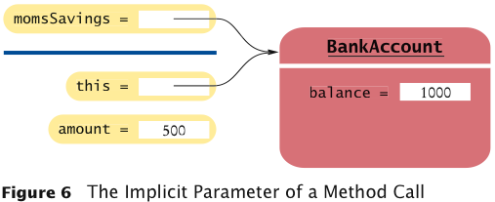
Implicit Parameters and this
Big Java by Cay Horstmann
Copyright © 2009 by John Wiley & Sons. All rights reserved.

Slide 46
Implicit Parameters and this
Some programmers feel that manually inserting the this reference before every instance variable reference makes the code clearer:
  public BankAccount(double initialBalance)
  {
  this.balance = initialBalance;
  }
Big Java by Cay Horstmann
Copyright © 2009 by John Wiley & Sons. All rights reserved.

Slide 47
Implicit Parameters and this
A method call without an implicit parameter is applied to the same object
Example:
  public class BankAccount
  {
  . . .
  public void monthlyFee()
  {
  withdraw(10); // Withdraw $10 from this account
  }
  }
The implicit parameter of the withdraw method is the (invisible) implicit parameter of the monthlyFee method
Big Java by Cay Horstmann
Copyright © 2009 by John Wiley & Sons. All rights reserved.

Slide 48
Implicit Parameters and this
You can use the this reference to make the method easier to read:
  public class BankAccount
  {
  . . .
  public void monthlyFee()
  {
  this.withdraw(10); // Withdraw $10 from this account
  }
  }
Big Java by Cay Horstmann
Copyright © 2009 by John Wiley & Sons. All rights reserved.

Slide 49
Self Check 3.20
How many implicit and explicit parameters does the withdraw method of the BankAccount class have, and what are their names and types?
Answer: One implicit parameter, called this, of type
BankAccount, and one explicit parameter, called amount, of
type double.
Big Java by Cay Horstmann
Copyright © 2009 by John Wiley & Sons. All rights reserved.

Slide 50
Self Check 3.21
In the deposit method, what is the meaning of this.amount? Or, if the expression has no meaning, why not?
Answer: It is not a legal expression. this is of type BankAccount
and the BankAccount class has no variable named amount. s
Big Java by Cay Horstmann
Copyright © 2009 by John Wiley & Sons. All rights reserved.

